Slide 1
A mini project on Furniture sales prediction
presented by:-
Narmula vamshikrishna

Slide 2
Business goal:-
To predict Sales of the furniture over the given period of time and forecast the sales for the next required period.
By analyzing the past data of furniture sales we can say what are the factors effecting their sales and the profits for the sales and whether to offer any discount or not.
By analyzing we can help the business to meet the needs of the business to be in the profit side.

Slide 3
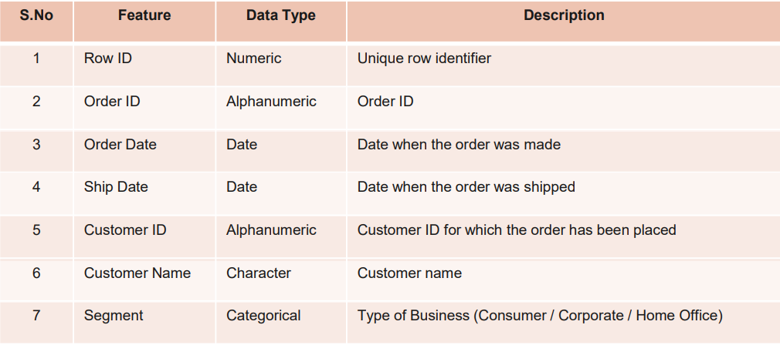
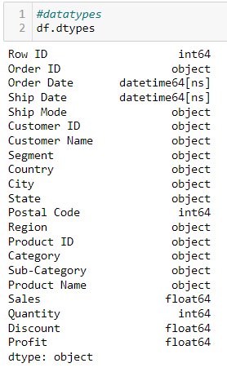
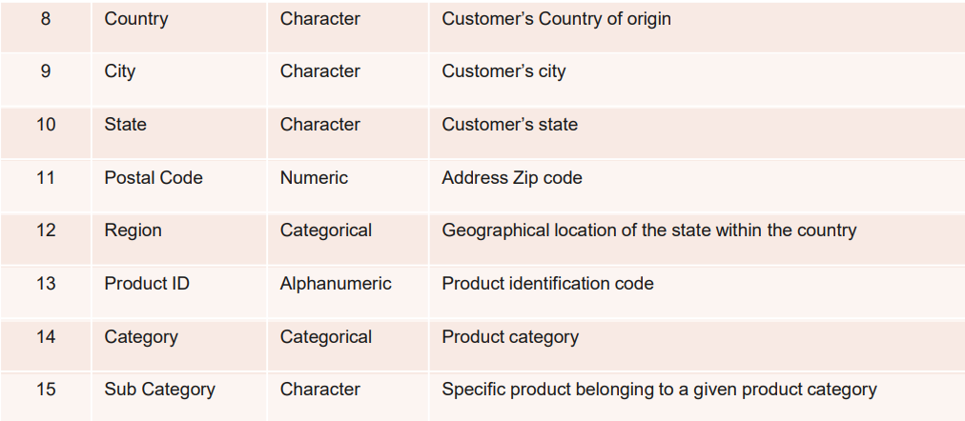
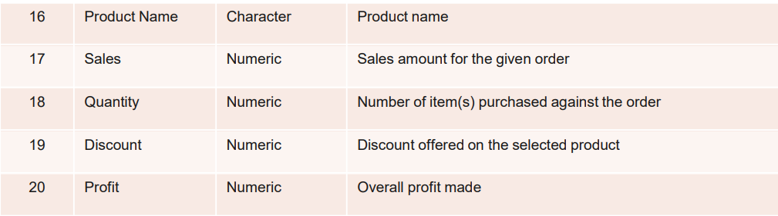
Data source and datatypes
The structure of the given dataset :
Rows = 9994
Columns = 21 (Ship Mode) feature is not mentioned.
Consider the furniture category to predict the sales of the furniture and copy in another dataset.
Rows = 2121
Columns = 21
The datatypes of the 21 features are shown in the picture which has
6 – Numeric columns
13 – Non_Numeric Columns
2 – Datetime columns

Slide 4
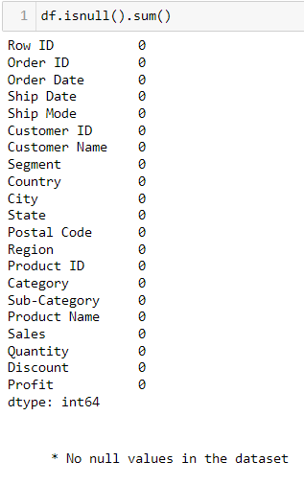
Imputation of missing values:
Check for the Null values in the given dataset.
There are no null values in the given dataset.
Check for Special characters in the given dataset.
There are no special characters in the given dataset.
Outlier Treatment for the given dataset.
There were outliers in the Sales feature so as we are predicting the sales only we have to ignore the outliers.
I used boxplot to check for outliers.

Slide 5
Eda process:-
Loading the data and reading the data.
Check for the structure.
Check for the datatypes
Check for null values.
No null values in the given dataset.
Data Visualization.
Checked for any special characters present in the data found no special characters.

Slide 6
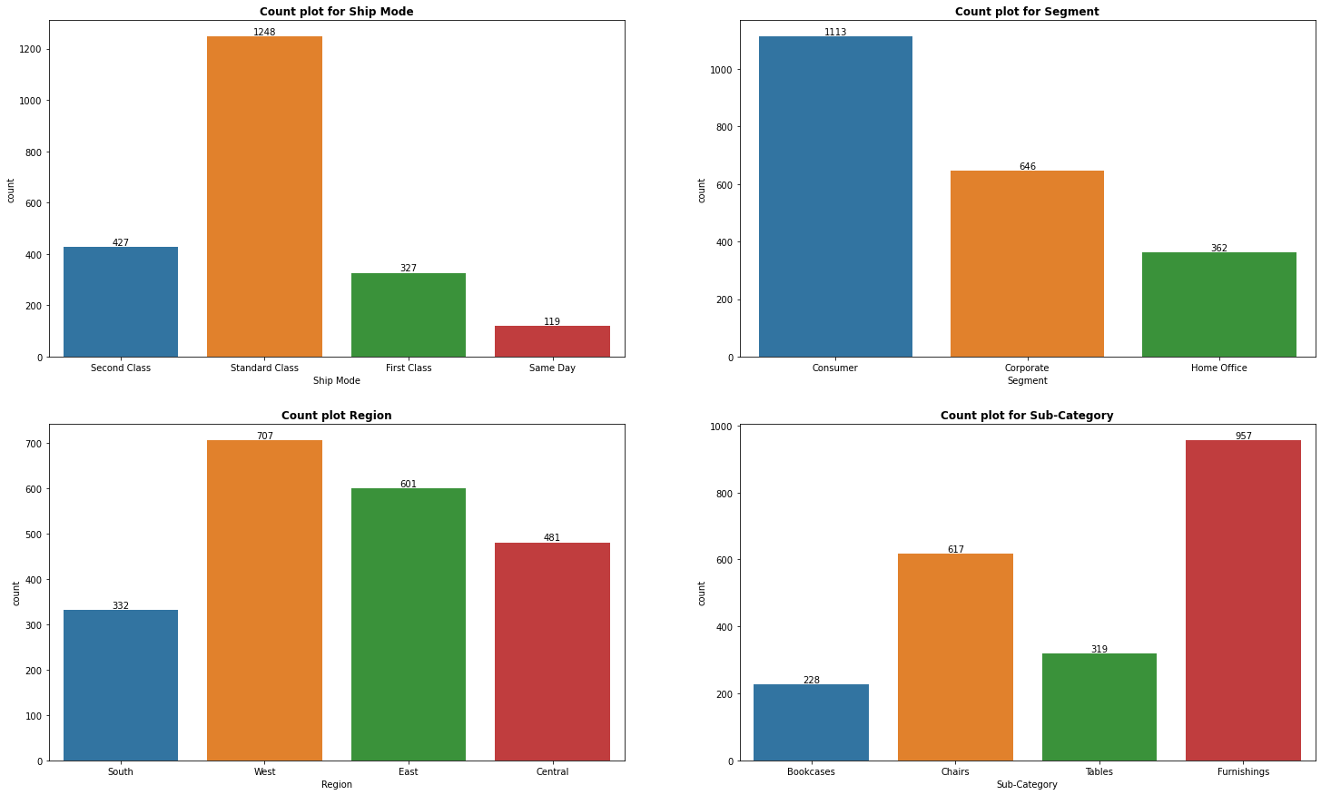
Visualizations:-
UNIVARIATE
Interpretation:-
For the Sales of Furniture
The mostly used Ship mode is 'Standard Class' followed by 'Second class'.
The highest segment the sales of furniture belongs to 'Consumer Segment'.
The most products of furniture are sold in the 'West region'.
The subcategory 'Furnishings' are mostly sold followed by 'Chairs'.

Slide 7
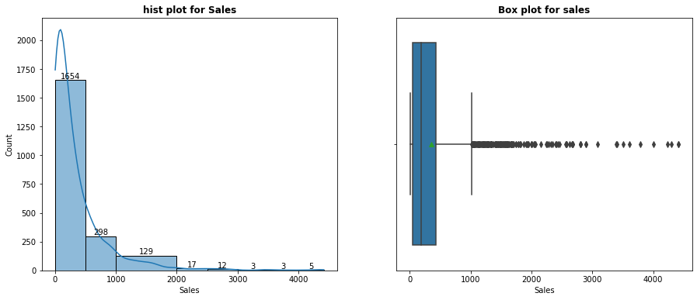
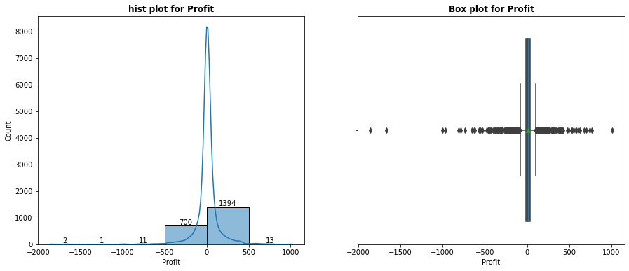
UNIVARIATE
Interpretation:-
The Sales are not distributed normally from the box plot we can see their are more outliers.
The mean is greater than median data is right skewed and the data is mostly towards the left.
Outliers are found in the given feature of Sales but ignore them.
The profits are not distributed normally from the box plot we can see their are more outliers.
The mean is less than median data is left skewed and the data is mostly towards the right.
Outliers are found in the given feature of profit but ignore them.

Slide 8
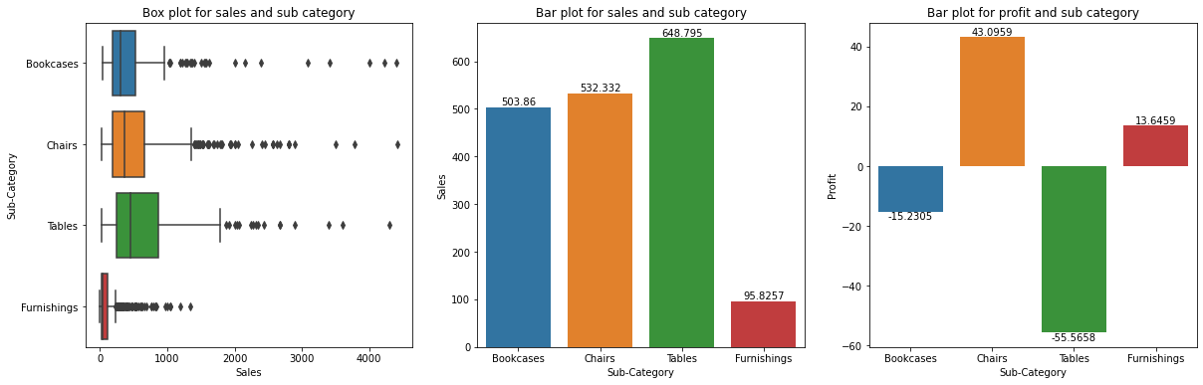
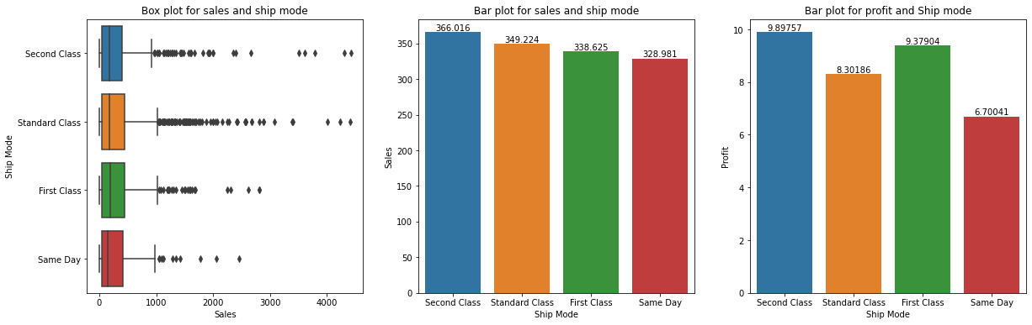
bivariate
Interpretation:- With Sub-category
The Sales of 'Tables' are highest compared to others but these products are not profitable they are in losses.
The Sales of 'Chairs' are second highest and the 'profits' are highest compared to other sub category products.
The Sales of 'Bookcases' are third highest but not profitable they are in losses.
The Sales of 'furnishings' are least but these sub category products are profitable.
Interpretation:- With Ship Mode
The Sales and the profits of the 'Second Class' ship mode are highest compared to other ship modes.
The Sales 'Standard Class' are second highest and the 'profits' are more compared to 'Same day' ship mode.
The Sales of 'First Class' are third highest but the profits are more than 'Standard class' and less than 'Second Class'.
The Sales and profits of 'Same Day' ship mode are least.

Slide 9
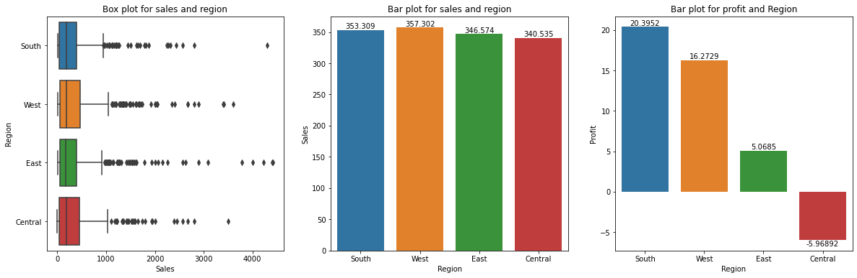
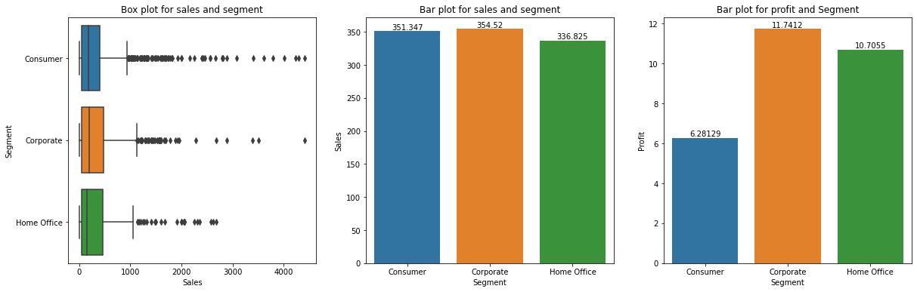
bivariate
Interpretation:- With Region
The Sales are Highest in the 'West Region' but the profits are less compared to 'South region'.
The Sales in 'South Region' are second highest and the 'profits' are highest compared to other regions.
The Sales in 'East Region' are third highest but profits are less than South and West regions.
The Sales in 'Central Region' are least and in these region products are not profitable.
Interpretation:- With Ship Mode
The Sales and profits are highest in 'Corporate Segment' compared to other segments.
In 'Consumer Segment' the Sales are second highest but the profits are least compared to other segments.
The Sales are least in 'Home Office' but the profits are more compared to 'Consumer Segment' and less compared to 'Corporate segment'.

Slide 10
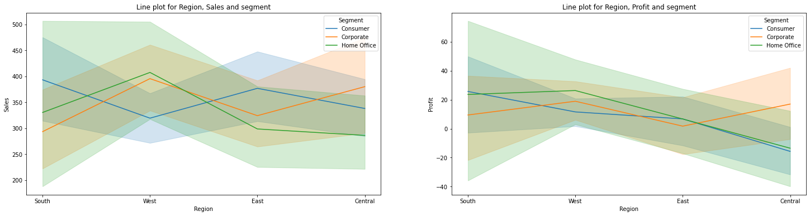
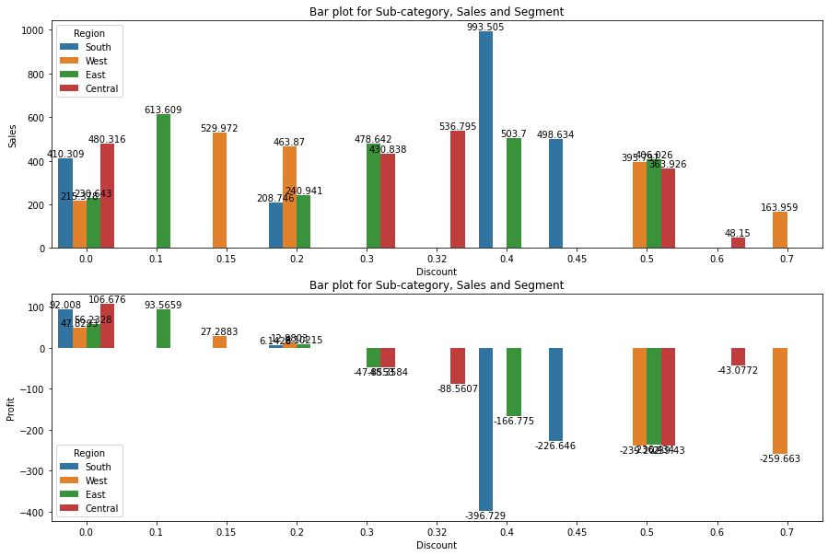
multivariate
Interpretation:-
For 'Home Office Segment' the Sales and profits are highest in the 'West Region' and least in 'Central region'.
For 'Corporate Segment' the Sales are highest in 'West region' and least in 'South region' and profits are highest in 'Central region' and least in 'East region'.
For 'Consumer Segment' the Sales are highest in 'south region' and least in 'West region' and profits are highest in 'South region' and least in 'Central region'.
Interpretation:-
There are losses for the products if the discount is more than 0.2 in all the regions.

Slide 11
Data Pre-processing:-
Set the index as the ‘Order Date’ .
Resampled the data to a weekly data by using the mean.
Plotted the seasonality components like Trend, Seasonality and Residual.
After that done the three different types of smoothening and evaluated the three smoothening models out of which simple exponential smoothening gives the least RMSE value.
Checked for the stationarity of the data and found the data is Stationary which allows me to proceed to build the model
The Hold-out method is used to split the data into the train data and test data with train size as 70%.
Firstly I found the p and q values by plotting the Autocorrelation and partial-autocorrelation plots.
After getting the p and q values I used the ARIMA model to predict the best p and q values by seeing the error for which gives me the least RMSE value.
I have used auto-arima function to find the best p and q values.
Out of which I have considered the p and q values which I got through the least RMSE value.

Slide 12
Selecting the best model
Used more than one algorithm:-
Yes, In this project i used more than one algorithm.
ARMA model
SARIMA model
SARIMAX model
Model Building:-
I have build the model for the above three algorithms by the train data and predicted the sales using the test data.
I have found the summary and predicted the sales using the test data.
Through summary I found the AIC and BIC values.
After that plotted a graph for the actual test data of sales and the predicted sales.
After plotting I have forecasted the sales for the next 1 year using the test-data for ARMA and SARIMA models and plotted the graph with the actual sales and forecasted sales for next 1year.
After forecasting I have done the evaluations for all the three algorithms from which I have found the MSE and RMSE values.
The error MSE,RMSE,AIC and BIC values of SARIMAX model is less compare to other models and the predicted test sales are nearer to the actual test data sales.

Slide 13
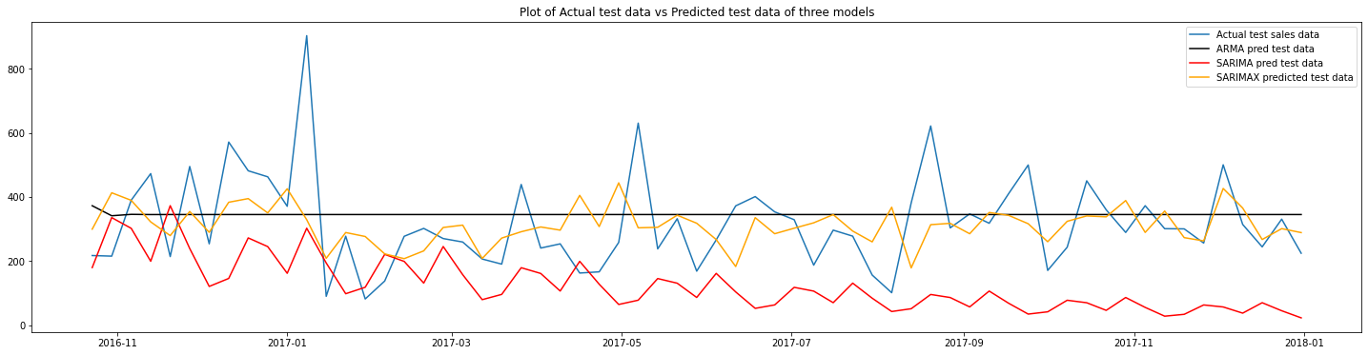
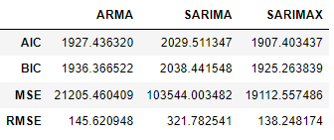
Interpretation:-
Using all the three algorithms I have predicted the sales using the test data out of which the SARIMAX model gives the best sales nearly same as actual sales.
ARMA model gives the constant Sales through prediction using the test data.
Conclusion:-
we can say the best model as SARIMAX by seeing the table.
From the graph we can observe that the blue colour trend shows the original sales test data.
The orange colour trend line is the predicted sales of the test data using the SARIMAX algorithm.

Slide 14
Thank you

